Slide 1
Project :
Intrusion Detection System using Raspberry Pi

Slide 2
Intrusion Detection System (IDS)
In the context of home automation, an Intrusion Detection System (IDS) is a security system designed to monitor and detect unauthorized or potentially malicious activities within a smart home environment. Home automation systems typically consist of various connected devices such as smart locks, cameras, motion sensors, and smart hubs, which can be vulnerable to security threats. An IDS for home automation is crucial for ensuring the security and privacy of a smart home.

Slide 3
Use cases of IDS
Smart Cities: IoT IDS can help monitor and protect critical infrastructure and services in smart cities, including surveillance cameras, traffic management systems, and utility grids.
Healthcare: IoT IDS can secure connected medical devices, patient health records, and healthcare systems against cyberattacks and data breaches.
Agriculture: In precision agriculture, IoT IDS can safeguard automated farming equipment, crop monitoring systems, and irrigation control.
Logistics and Supply Chain: IoT IDS can help secure the tracking and monitoring of goods and shipments, ensuring the integrity of data and protection against theft or tampering.

Slide 4
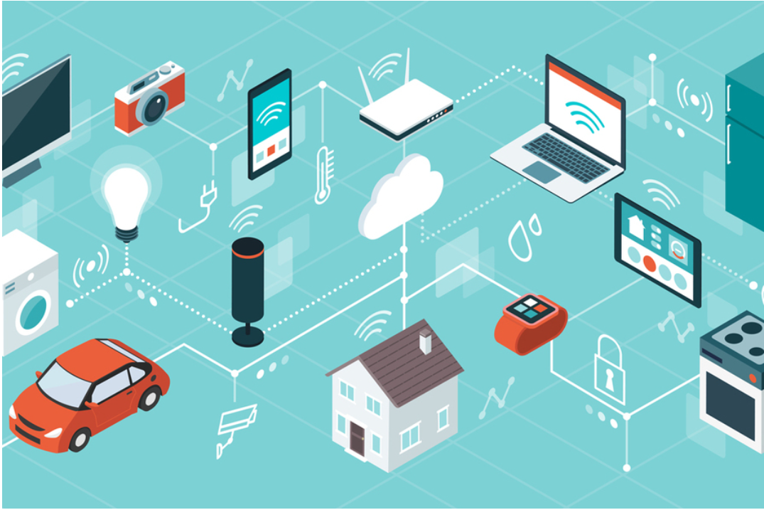
Components used
Raspberry Pi
Pi Camera
PIR Sensor
Power supply
Jumper Cables
SD card

Slide 5
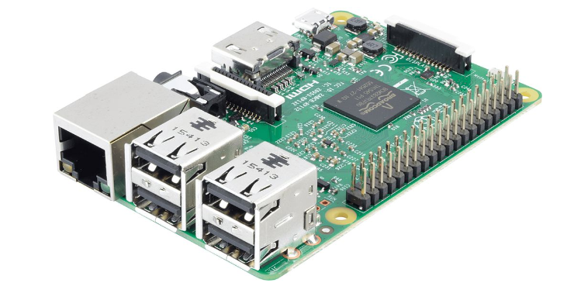
Raspberry Pi
Is a small, affordable single-board computer that can be used for various projects. It serves as the brain of your project and can run software to control and interface with other components.

Slide 6
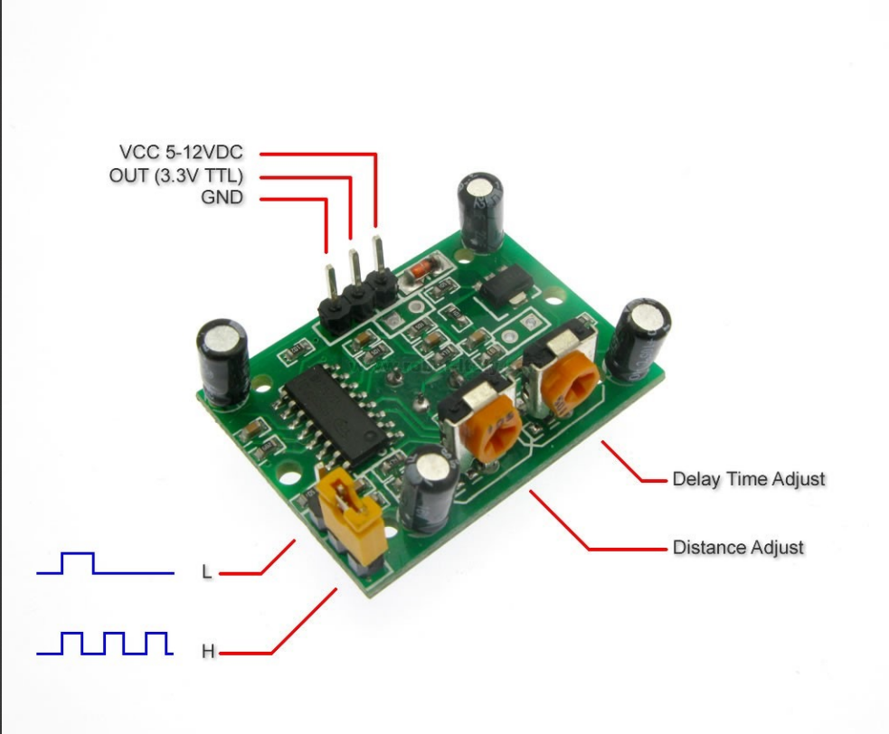
PIR Sensor
A motion sensor that detects changes in infrared radiation, such as body heat. PIR sensors are used to detect motion and are commonly used in security systems and automation projects.

Slide 7
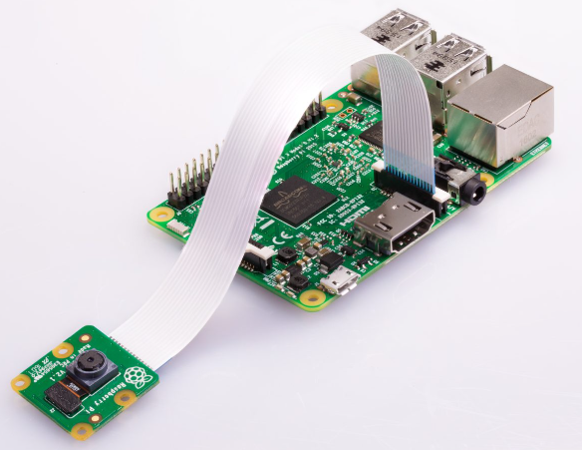
Pi Camera
It is a camera module specifically designed for the Raspberry Pi. It can capture photos and videos and is often used for surveillance, photography, and image processing projects.

Slide 8
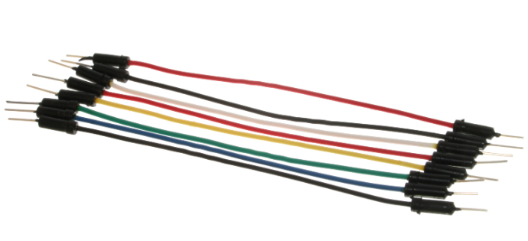
Jumper cables
Jumper cables are short, insulated wires with connectors that enable you to easily connect and transfer electrical signals or power between different components like sensors, microcontrollers, and other devices, helping to create a functional IoT system.

Slide 9
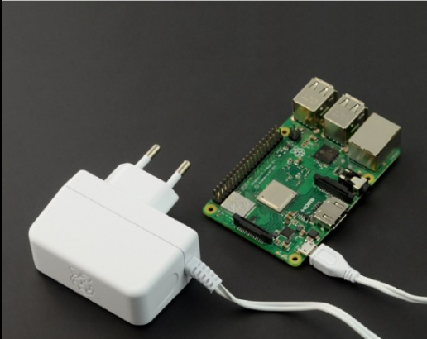
Power supply
A power source, often used to provide electrical power to your Raspberry Pi and other components. For a Raspberry Pi, this might be a micro USB power supply. The voltage and current supplied should match the requirements of your components.

Slide 10
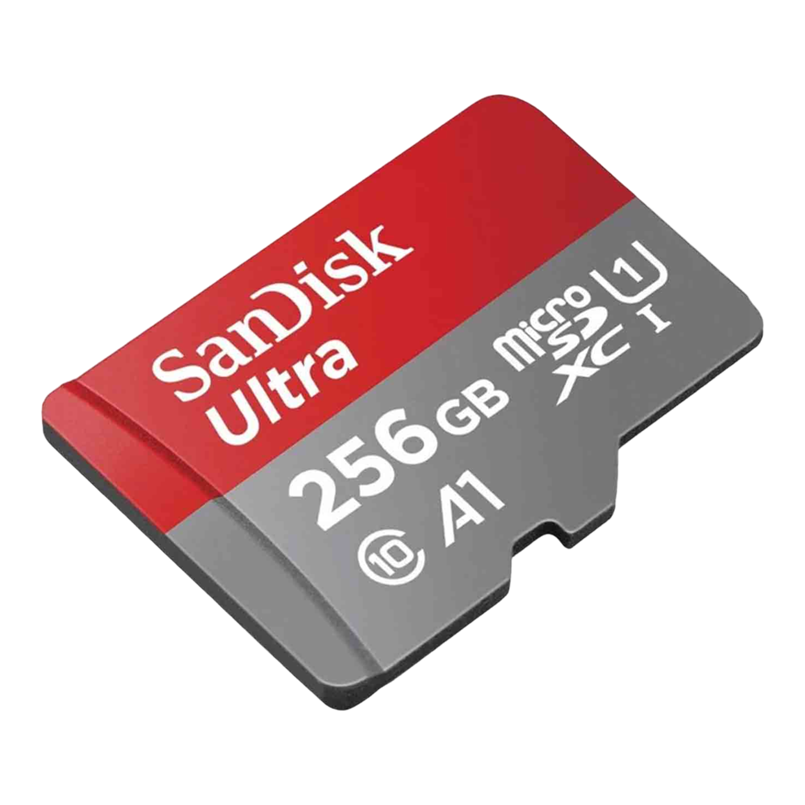
Micro SD Card
In a Raspberry Pi IoT project, the micro SD card serves as the storage and boot medium, housing the operating system, software, and data. It enables the Raspberry Pi to run IoT applications, store sensor readings, and maintain persistence across power cycles.

Slide 11
Our Project
This system will detect the presence of Intruder and quickly alert the user by sending him a alert mail. This mail will also contain the Picture of the Intruder, captured by Pi camera. Raspberry Pi is used to control the whole system. This system can be installed at the main door of your home or office and you can monitor it from anywhere in the world using your Email over internet.

Slide 12
Working of our Project
Whenever anyone or intruder comes in range of PIR sensor, the PIR sensor triggers the Pi Camera through Raspberry Pi. Then Raspberry pi sends commands to Pi camera to click the picture and save it. After this, Raspberry Pi creates an email and sends it to the defined email address with recently clicked images. The mail contains a message and picture of intruder as attachment.

Slide 13
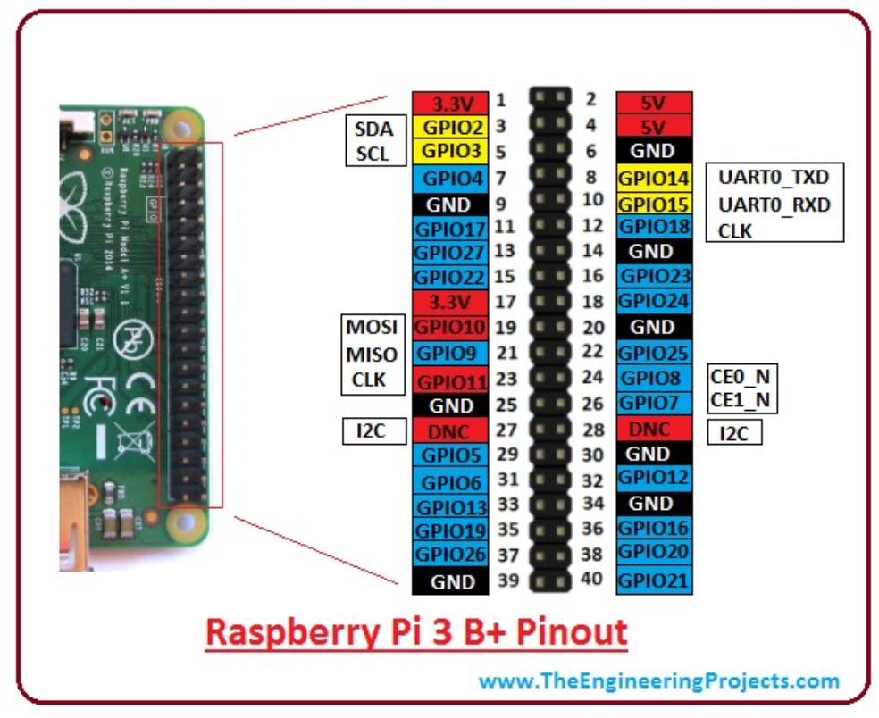
Circuit Design
In this Intruder Alert System, Pi Camera is connected at the camera slot of the Raspberry Pi and PIR is connected to GPIO pin 17.

Slide 14
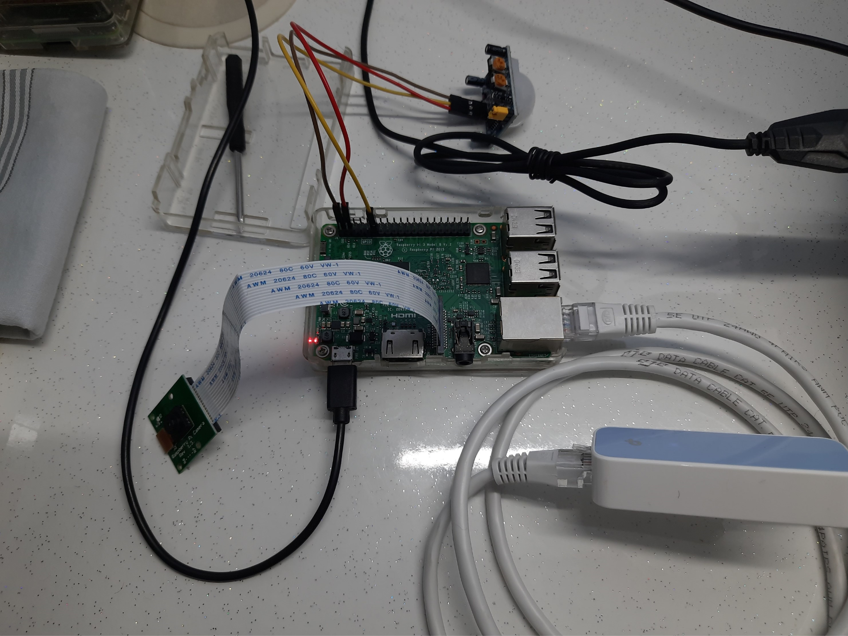
Circuit Design

Slide 15
Challenges faced
False Positives/Negatives: PIR sensors, which detect motion, can sometimes be triggered by false positives (e.g., changes in temperature or lighting) or miss real intrusions. Tuning the sensor's sensitivity and accuracy can be challenging.
Google SMTP Server: For gmail, google doesn’t allow 3rd party applications like raspberry pi to send or receive emails directly. To bypass this, One-time app passwords should be used.
Data Storage and Retrieval: Deciding where and how to store the data generated by the system (e.g., images, logs) and how to retrieve and manage it can be challenging, especially if you plan for long-term storage.

Slide 16
Thank You

